Slide 1


Adrián Pérez
27/10 /2023

Slide 2
OUTLI NE
Executive Summary
Introduction
Methodology
Results
Conclusion
Appendix
2

Slide 3
EXECUTIVE SUMMARY
Methodologies used for analyzing the data:
Data was collected using SpaceX API and web scraping Wikipedia’s SpaceX page.
Exploratory Data Analysis (EDA), including data wrangling and data visualization.
Machine learning prediction models.
Summary of results obtained:
EDA allowed us to know which features pick to predict the probability of successful landing.
Machine learning prediction allowed us to estimate the total cost of a launching based on the
probability of a successful launching.
3

Slide 4
INTRODUC
Background:
TION
SpaceX has the best pricing ($62 million vs. $165 million USD) for rocket launchings due to the fact that they are capable of recovering the Stage 1 of the rocket. In order to be a competitive company against SpaceX, SpaceY also wants to be capable of this.
Objective:
⯈ To train a machine learning model to predict successful Stage
1 recovery to estimate the total cost of a launching.
4

Slide 5

Section 1
5

Slide 6
METHODOL OGY
Executive Summary
Data collection methodology:
Combined data from SpaceX public API and SpaceX Wikipedia page.
Perform data wrangling
Classifying true landings as successful and unsuccessful.
Perform exploratory data analysis (EDA) using visualization and SQL
Perform interactive visual analytics using Folium and Plotly Dash
Perform predictive analysis using classification models
Tuned models using GridSearchCV.
6

Slide 7
DATA COLLECTION
Data sets were collected using a combination of SpaceX API and web
scraping SpaceX Wikipedia’s page.
Space X API Data Columns:
FlightNumber, Date, BoosterVersion, PayloadMass, Orbit, LaunchSite, Outcome, Flights, GridFins, Reused, Legs, LandingPad, Block, ReusedCount, Serial, Longitude, Latitude
Wikipedia Webscrape Data Columns:
Flight No., Launch site, Payload, PayloadMass, Orbit, Customer, Launch
outcome, Version Booster, Booster landing, Date, Time
7

Slide 8
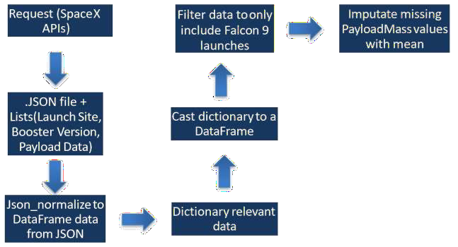
DATA COLLECTION – SPACEX API
Github URL:
https://github.com/krishnamanc/Applied-Data-Science-Capstone/blob/main/jupyter-labs-spacex-data-collection-api.ipynb
8

Slide 9
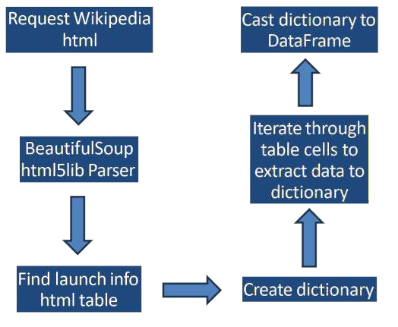
DATA COLLECTION - SCRAPING
GitHub URL:
https://github.com/krishnamanc/Applied-Data-Science-Capstone/blob/main/jupyter-labs-webscraping.ipynb
9

Slide 10
DATA WRANGLING
First, we performed Exploratory Data Analysis on the dataset.
Then, we calculated the summaries launches per site, occurrences of each orbit and occurrences of mission outcome per orbit.
Last, we created the landing outcome label from ‘Outcome’ column.
Github URL: https://github.com/krishnamanc/Applied-Data-Science-Capstone/blob/main/labs-jupyter-spacex-Data%20wrangling.ipynb
10

Slide 11
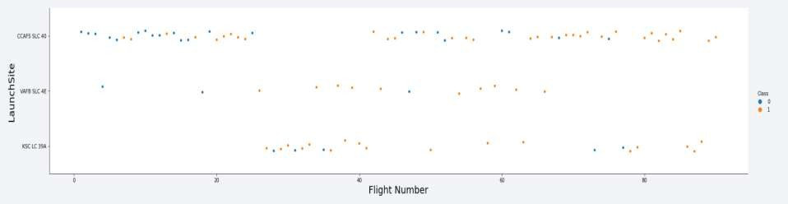
EDA WITH DATA VISUALIZATION
To visualize relationship between a pair of features, we used scatterplots and
barplots.
Payload-Orbit, Launch Site-Payload Mass, Orbit-Flight Number, Payload Mass-Flight Number,
Launch Site-Flight Number.
Github URL: https://github.com/krishnamanc/Applied-Data-Science-Capstone/blob/main/jupyter-labs-eda-dataviz.ipynb.jupyterlite.ipynb
11

Slide 12
EDA WITH SQL
SQL queries performed:
Names of unique launch sites in the mission
Top 5 launch sites that begin with ‘CCA’.
Total payload mass carried by boosters.
Average payload mass carried by booster F9.
Date of first successful landing in ground pad.
Boosters with successful landing on drone ship and payload mass between 4000 and 6000 Kg.
Total successful and failed outcomes.
Boosters which have carried maximum payload mass.
Failed landings on drone ship, their boosters and launch site names (2015)
Github URL: https://github.com/krishnamanc/Applied-Data-Science-Capstone/blob/main/jupyter-labs-eda-sql-coursera_sqllite.ipynb
12

Slide 13
BUILD AN INTERACTIVE MAP WITH FOLIUM
In Folium Maps we used markers, circles, lines and marker clusters.
Markers are used for indicating launch sites.
Circles for highlighting areas.
Lines for measuring distances between 2 points.
Marker clusters indicate groups of events in each coordinates (launches in a launch site).
Github URL: https://github.com/krishnamanc/Applied-Data-Science-Capstone/blob/main/lab_jupyter_launch_site_location.jupyterlite.ipynb

Slide 14
BUILD A DASHBOARD WITH PLOTLY DASH
We used the following plots for visualizing payload range and the percentage
of launches per site.
This allowed us to identify relationship between payloads and launch sites
and find the best launching site according to payloads.

Slide 15
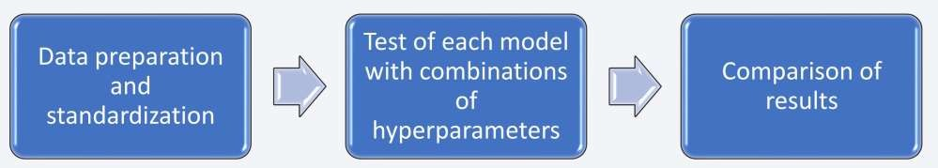
PREDICTIVE ANALYSIS (CLASSIFICATION)
We compared 4 machine learning models for classification: Logistic
Regression, SVM, Decision tree and KNN.
Github URL: https://github.com/krishnamanc/Applied-Data-Science-Capstone/blob/main/SpaceX_Machine_Learning_Prediction_Part_5.jupyterlite.ipynb

Slide 16
RESULT S
EDA results:
SpaceX uses 4 launch sites.
Average payload for F9 booster is 2928 Kg.
First successful landing took place in 2015.
Many F9 boosters were successful landing on drone ship carrying a payload above average.
Only 2 booster versions failed landing on drone ship in 2015 (F9 v1.1 B1012 and F9 v1.1 B1015)
As years passed, the number of successful landings improved.

Slide 17
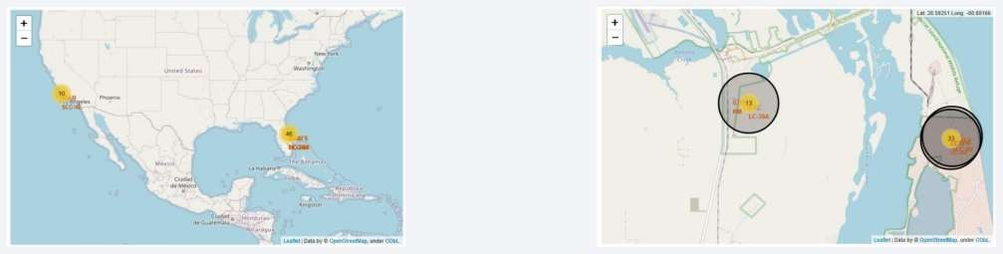
RESULT S
With Folium Maps, we learned that launch sites are located on seaside places with
good logistics infrastructure.

Slide 18
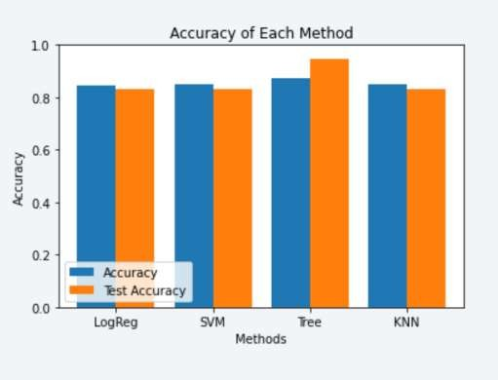
RESULT S
We also discovered that Decision tree classification model was the most accurate at the time of predicting successful landings (training data 87% accuracy, testing data 94% accuracy).

Slide 19

Section 2

Slide 20
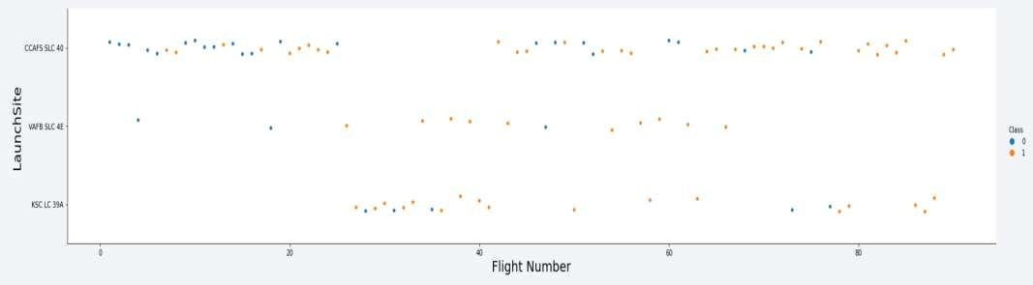
FLIGHT NUMBER VS. LAUNCH SITE
In this plot, we can see that the best launch site is CCAF5 SLC 40.
Rate success improved over time.

Slide 21
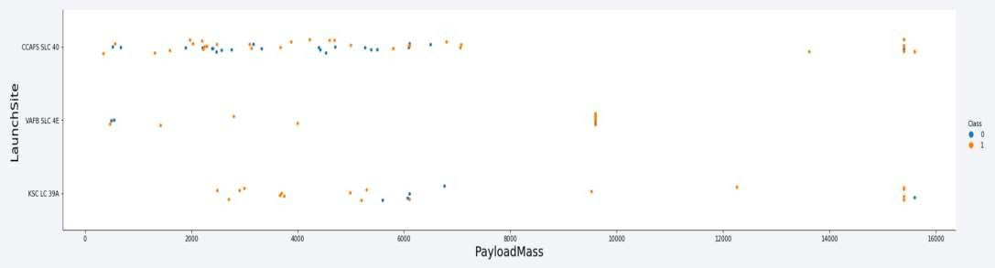
PAYLOAD VS. LAUNCH SITE
As we can see, payloads over 9000 Kg have high success rate.

Slide 22
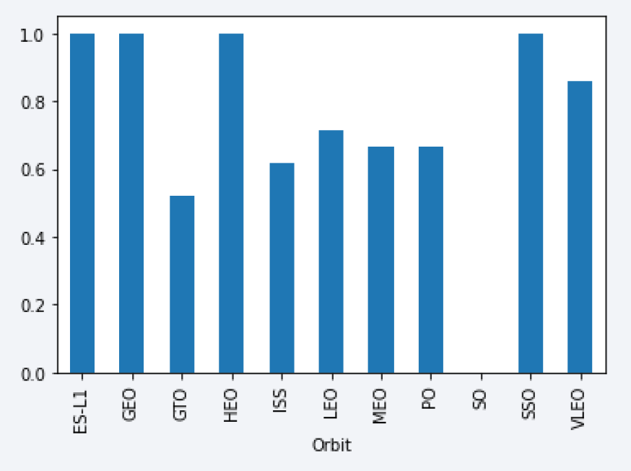
SUCCESS RATE VS. ORBIT TYPE
Highest success rate occurs in orbits ES-L1, GEO, HEO and SSO.

Slide 23
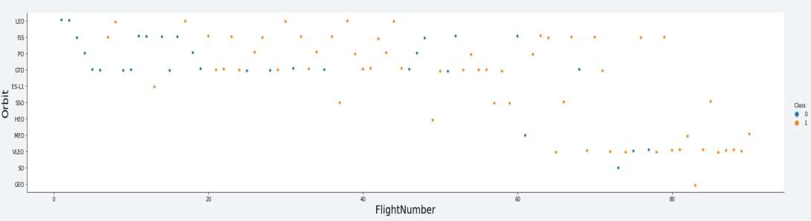
FLIGHT NUMBER VS. ORBIT TYPE
Success rate improved over time in the orbits

Slide 24
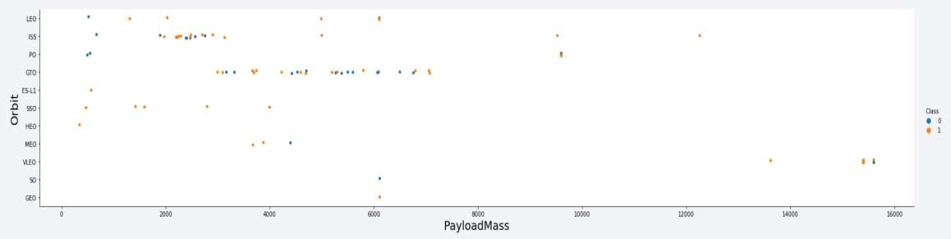
PAYLOAD VS. ORBIT TYPE
The widest range of payload and nice success rate goes to ISS orbit.
No apparently relationship between payload and success rate in orbit GTO.

Slide 25
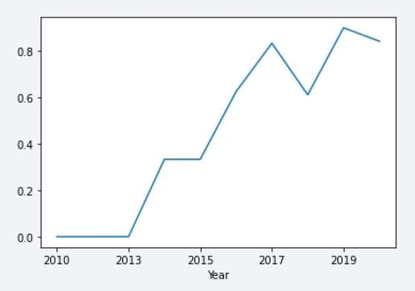
LAUNCH SUCCESS YEARLY TREND
Success rate trend is positive, it has been going up since 2013 till nowadays.

Slide 26
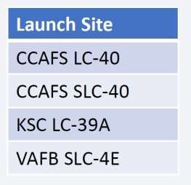
ALL LAUNCH SITE NAMES
There are 4 launch sites, as we can see in the table above.
We found them querying the unique occurrences for ‘launch_site’.

Slide 27
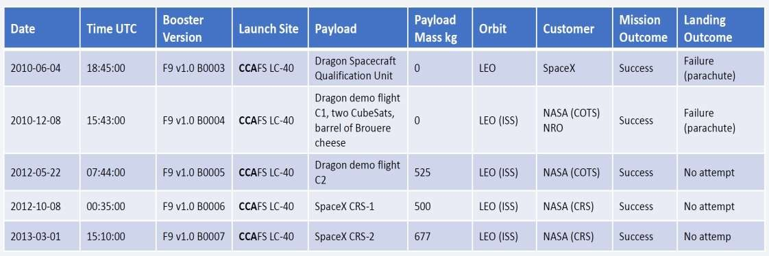
LAUNCH SITE NAMES BEGIN WITH 'CCA'
5 records where launch sites begin with `CCA`

Slide 28
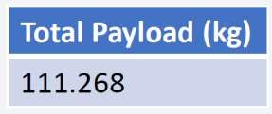
TOTAL PAYLOAD MASS
Above is shown the total payload carried by NASA boosters.
It was calculated by summing all payloads containing the string ‘CRS’
(corresponds to NASA) in their code.

Slide 29
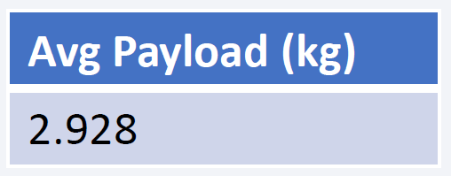
AVERAGE PAYLOAD MASS BY F9 V1.1
Above is shown the average payload mass carried by booster version F9 v1.1
To find this number, we filtered the data by booster version and calculated
the mean.

Slide 30
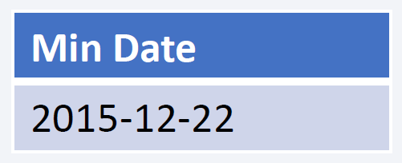
FIRST SUCCESSFUL GROUND LANDING DATE
Above is shown the date of first successful landing outcome on ground pad.
We found this date filtering data by successful landing on ground pad and
minimum value for date.

Slide 31
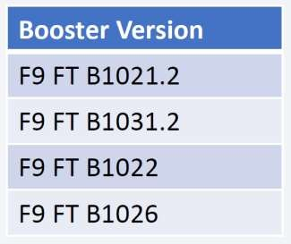
SUCCESSFUL DRONE SHIP LANDING WITH PAYLOAD BETWEEN 4000 AND 6000
Above is shown a list with the names of boosters which have successfully landed on
drone ship and had payload mass greater than 4000 but less than 6000.
• We retrieved this list by filtering data by distinct booster versions.

Slide 32
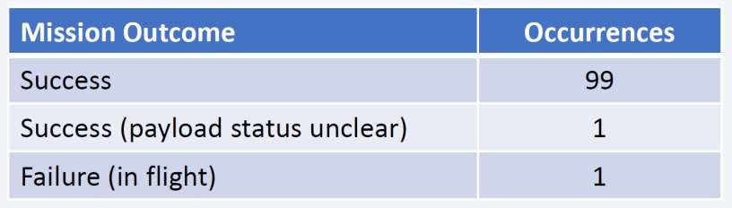
TOTAL NUMBER OF SUCCESSFUL AND FAILURE MISSION OUTCOMES
Above is shown the total number of successful and failure mission outcomes.
We grouped by mission outcome and counting records for each group.

Slide 33
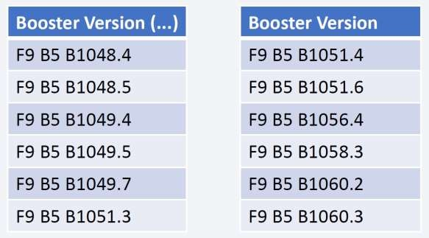
BOOSTERS CARRIED MAXIMUM PAYLOAD
These are the boosters which have carried the maximum payload mass.

Slide 34
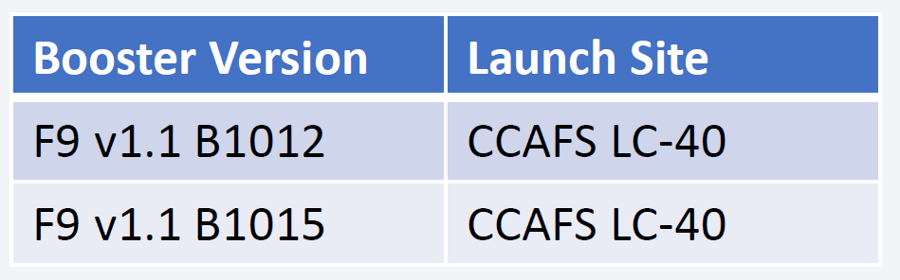
2015 LAUNCH RECORDS
These are the failed landing_outcomes in drone ship, their booster versions,
and launch site names for in year 2015

Slide 35
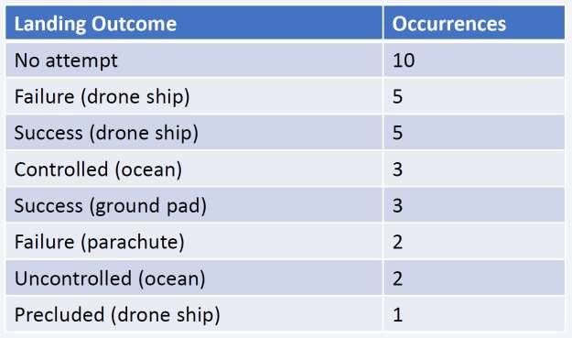
RANK LANDING OUTCOMES BETWEEN 2010-06-04 AND
2017-03-20
Ranking of landing outcomes (such as Failure (drone ship) or Success (ground
pad)) between the date 2010-06-04 and 2017-03-20, in descending order:

Slide 36

Section 3

Slide 37
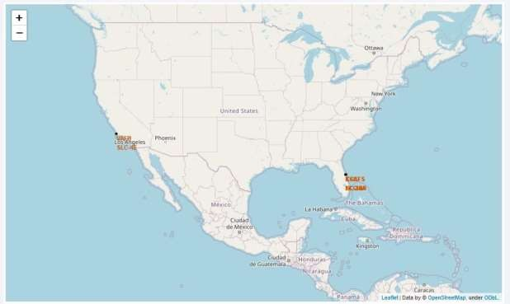
LAUNCH SITES
In this folium map we can see the different launch sites over the United States. They’re all located on the seaside.

Slide 38
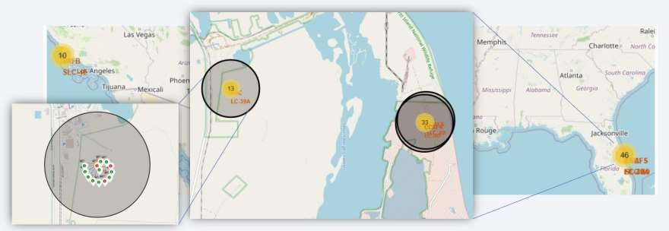
LAUNCH OUTCOMES FOR EVERY SITE
Example of the outcomes for KSC LC-39A launch site.
Green markers mean successful outcome, red markers failed outcome.

Slide 39
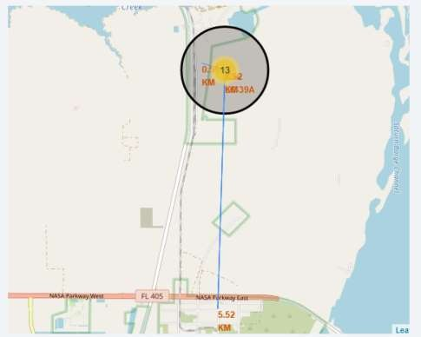
LOGISTI CS
Here we are showing launch site KSC LC- 39A. As we said before, it is located near the sea for safety purposes and good logistics infrastructure.

Slide 40

Section 4

Slide 41
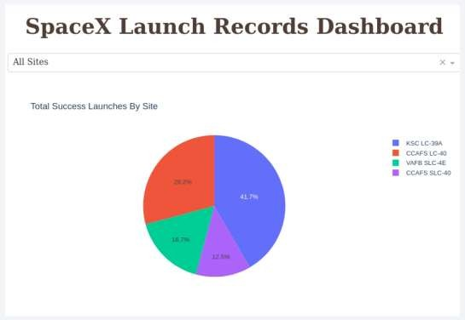
SUCCESSFUL LAUNCHES PER SITE
Above we can see a pie chart where is indicated the percentage of successful
launches on every site.
41

Slide 42
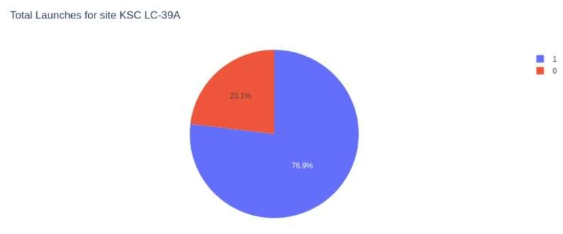
LAUNCH OUTCOMES FOR SITE KSC LC-39A
In KSC LC-39A launch site, 76,9% of the launches were successful (1).
42

Slide 43
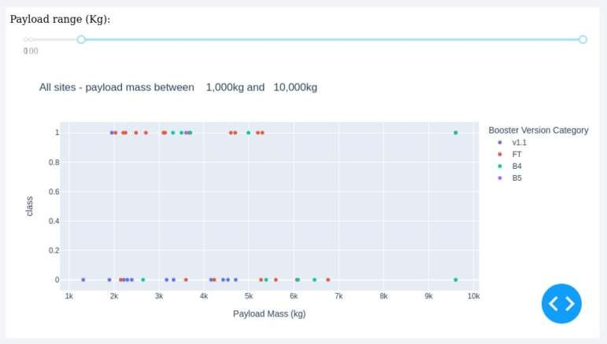
PAYLOAD VS LAUNCH OUTCOME
The combination Payload = 6000 Kg and Booster Version = FT is the most
successful one.
43

Slide 44
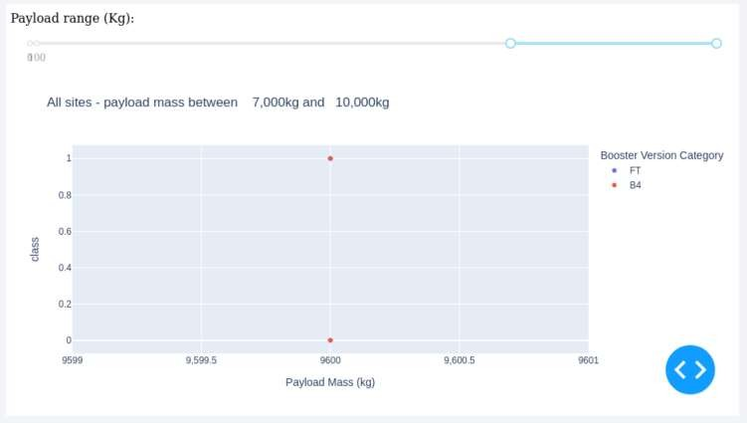
PAYLOAD VS LAUNCH OUTCOME
There is no data enough to make any insight.
44

Slide 45

Section 5

Slide 46
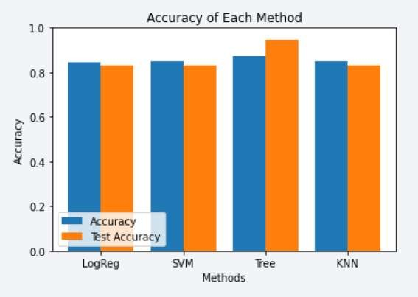
CLASSIFICATION ACCURACY
We tested the accuracy of 4 classification models: Logistic Regression, SVM, Decision Tree and KNN.
The highest classification model accuracy was given in the Decision Tree, with 87%.

Slide 47
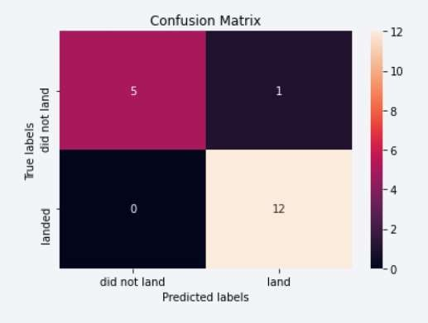
CONFUSION MATRIX
This is the confusion matrix of Decision Tree model. As we can see, there were little false positives and false negatives, so it is proved the accuracy of the model.

Slide 48
CONCLUSI ONS
Best launch site is KSC LC-39A.
Launches with payload above 7000 Kg have higher success rate.
Decision Tree classifier has proved to be the best model to predict the outcome of a
launch out of the 4 tested.
The success rate has improved over time, as it did rockets and boosters.

Slide 49
